Slide 1
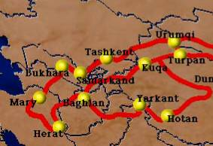
The chief city
Tashkent
Bukhara
Samarkand

Slide 2
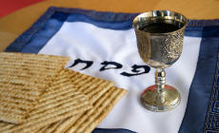
Messiah in the Passover

Slide 3
Romans 11:11
Again I ask: Did they stumble so as to fall beyond recovery? Not at all! Rather, because of their transgression, salvation has come to the Gentiles to make Israel envious.

Slide 4
Again I ask: Did they stumble so as to fall beyond recovery? Not at all! Rather, because of their transgression, salvation has come to the Gentiles to make Israel envious. Romans 11:11
Israel fell
Not beyond recovery
Reason: salvation of Gentiles
Does our faith arouse envy?

Slide 5
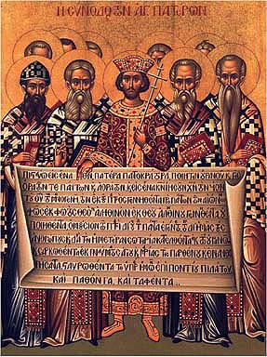
Council of Nicea 325 c.e.
Πιστεύομεν εἰς ἕνα Θεὸν Πατέρα παντοκράτορα, πάντων ὁρατῶν τε και ἀοράτων ποιητήν.

Slide 6
Council of Nicea 325 c.e.
No celebration of Easter with Passover:
For it is unbecoming beyond measure that on this holiest of festivals we should follow the customs of the Jews. Henceforth let us have nothing in common with this odious people…

Slide 7
Augustine 415 c.e.
The true image of the Hebrew is Judas Iscariot, who sells the Lord for silver. The Jew can never understand the Scriptures and forever will bear the guilt for the death of Jesus.

Slide 8
The First Crusade 1096
12,000 killed in Rhine Vally alone
1099
Crusaders Burn Jews alive in The Great Synagogue in Jerusalem

Slide 9
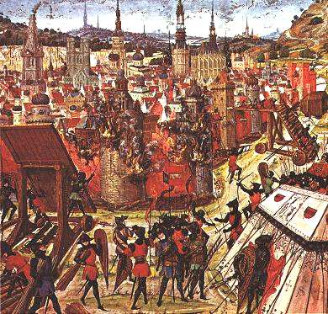

Slide 10
Martin Luther Against the Jews and Their Lies
1543

Slide 11
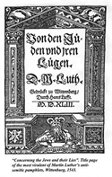

Slide 12
In the first place, their synagogues should be burned down and what does not burn must be covered with mud. This must be done for the honor of God and Christianity….
In the second place, their houses should be pulled down and destroyed. They must be housed in stables like gypsies….

Slide 13
Third, their books should be taken from them.
Fourth, rabbis should be forbidden to give any more lessons on pain of death.
Fifth, they should not be allowed to move around freely. Let them stay home…
Seventh, they should be put to work.

Slide 14
-German Lutheran Pastor Martin Niemoller
“In Germany, they came first for the Communists, And I didn’t speak up because I wasn’t a Communist;
And then they came for the trade unionists, And I didn’t speak up because I wasn’t a trade unionist;
And then they came for the Jews, And I didn’t speak up because I wasn’t a Jew
And then they came for me And by that time there was no one left to speak up.”

Slide 15
Exceptions:
Dietrich Bonhoeffer-
Lutheran Pastor executed for treason
Corrie tenBoom-
arrested for helping Jews Father and sister murdered by the Nazis

Slide 16
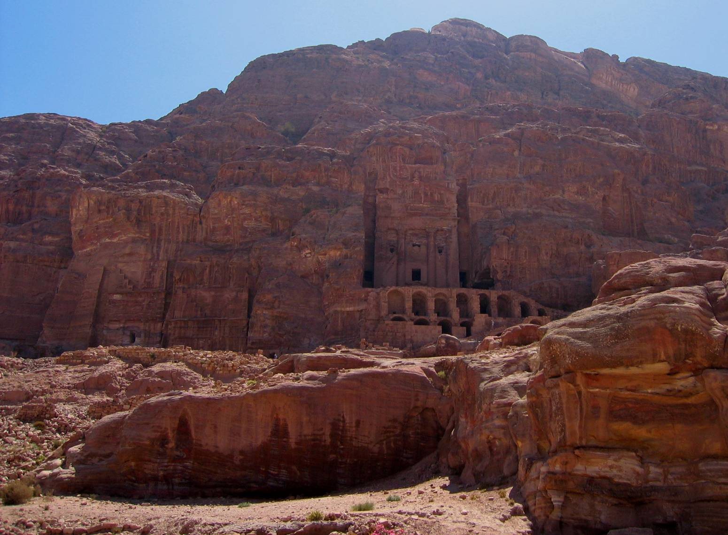
The Fall Feasts of Israel

Slide 17
All the feasts:
Leviticus 23
Spring: Passover, Unleavened Bread, First Fruits
Jesus fulfilled them all…

Slide 18
The Summer:
Shavu’ot= Pentecost
7 weeks/ _____ days after Passover. The Holy Spirit Fell, Church is born

Slide 19
The Fall Feasts-
Foretelling the End of Time?
Leviticus 23:23-44

Slide 20
5. Blowing of Trumpets
Now: Rosh HaShana
Cycle of Jewish Year
Begins 10 Days of Awe

Slide 21
May you have a sweet year…
Tashlikh- throwing away sins

Slide 22
The Fulfilment:
Jesus returns with a trumpet/shofar blast:

Slide 23
Prophetic Fulfilment:
Jesus returns with a trumpet/shofar blast:

Slide 24
1 Thessalonians 4:16-18
“For the Lord himself will come down from heaven, with a loud command, with the voice of the Archangel and with the trumpet call of God ….encourage each other with these words.”

Slide 25
6. Yom Kippor- Day of Atonement Fulfilled in Jesus-

Slide 26
Hebrews 9:13-14
“For if the blood of goats and bulls, and the ashes of a heifer sprinkling those who have been defiled, sanctify to the cleanness of the flesh; how much more will the blood of Messiah, who through the eternal Spirit offered himself without blemish to god, cleanse your conscience from dead works to serve the living God?”

Slide 27
Prophetic Fulfilment- Tribulation?

Slide 28
7. Feast of Booths/
Tabernacles (Sukkot)

Slide 29
Fulfilment: God dwelling with men (including Gentiles) in the Millenium.

Slide 30
Zechariah 14:16
“It will happen that everyone who is left of all the nations that come against Jerusalem will go up from year to year to worship the King, the Lord of Hosts, and to keep the feast of booths.”

Slide 31
Review:
7 Feasts:
Three in the Spring:
1.
2.
3.

Slide 32
7 Feasts:
One in the Summer
(hint: 50, Holy Spirit)
4.

Slide 33
7 Feasts:
Three in the Fall:
5.
6.
7.

Slide 34
What do they mean?
Trumpets-
Yom Kippor- Day of Atonement
Sukkot/ Tabernacles

Slide 36
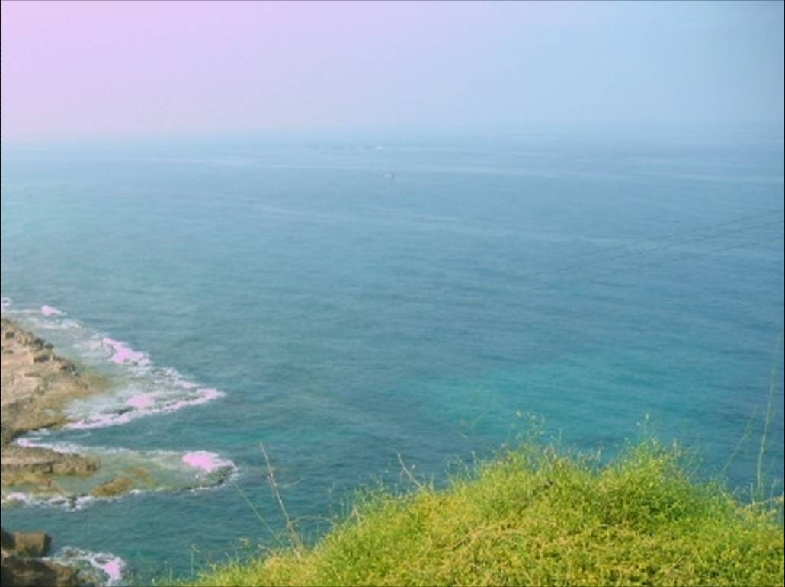
Origin: Feast of Trumpets or..
Feast of Rememberance
Lev. 23

Slide 37
Introduction: Rosh HaShana in Judaism:
Rambam explained the custom of blowing shofar as a wake-up call to sleepers, designed to rouse us from our complacency. It is a call to repentance. The blast of the shofar is a very piercing sound when done properly.
(Blowing of the Shofar)

Slide 38
Follows intense prayer in synagogue (slikhot)
Starts 10 Days of Awe before Yom Kippor

Slide 39
“Jewish New Year is a time to begin introspection, looking back at the mistakes of the past year and planning the changes to make in the new year.”
“Rosh HaShana” @ jewfaq.org/ judaism 101

Slide 40
Forgiveness, confession of sin. Search for things that make you unfit for God’s presence.
Result:
“May your name be inscribed in the book of life”
What is the book of life?

Slide 41
I kept looking until thrones were set up, and the Ancient of Days took His seat; his vesture was like white snow and the hair of His head like pure wool; his throne was ablaze with flames, its wheels were a burning fire. A river of fire was flowing and coming out from before Him; thousands upon thousands were attending Him, and myriads upon myriads were standing before Him; the court sat, and the books were opened. Daniel 7:9-10
(Who is the Ancient of Days and what are the books?)

Slide 42
The Book of Life in Daniel is Distressing
Daniel 7:8-10 describes a supernatural figure, the Ancient of Days. Who is that?
The books are legal books. What do you think that means?
(Ever been to court before a judge? Randall’s story)

Slide 43
I kept looking in the night visions, and behold, with the clouds of heaven, one like a Son of Man was coming, and He came up to the Ancient of Days and was presented before Him. And to Him was given dominion, glory and a kingdom, that all the peoples, nations and men of every language might serve Him. His dominion is an everlasting dominion which will not pass away; and His kingdom is one which will not be destroyed.
Daniel 7:13-14

Slide 44
7:13-14 Who is the person who appears together with the Ancient of Days?

Slide 45
Now at that time Michael, the great prince who stands guard over the sons of your people, will arise and there will be a time of distress such as never occurred since there was a nation until that time; and at that time your people, everyone who is found written in the book, will be rescued. Many of those who sleep in the dust of the ground will awake, these to everlasting life, but the others to disgrace and everlasting contempt. (Daniel 12:1-2)

Slide 46
Yom Kippur- Do we know if our name is written?
The blowing of the GREAT SHOFAR..
Will this be a happy event for you?
Thessalonians’ context was comfort.

Slide 47
2. The Book of Life Should be Comforting

Slide 48
“For the Lord himself will descend from heaven with a shout, with the voice of the chief angel, and with God’s shofar, and the dead in Messiah will rise first…. Comfort one another with these words.”
I Thess. 4:16, 18

